Slide 1

School Accounts
2023-2024
Rhondalyn Williams
Internal Auditor
Lenesius Kinnon Mirza Nunez-
School Accounts Auditor School Accounts Auditor
Emily Bognar
Accounts Specialist
July 31, 2023

Slide 2

TEAMS
Meeting Dates
July 31, 2023
November 07, 2023
March 05, 2024
May 07, 2024
Please see the above dates for fiscal year 23-24 training. All system updates, policy changes and procedures will be discussed when school accounts is notified. Secretary training will continue to address topics reviewed in audits as they arise, along with issues addressed prior to the quarterly training. Personalized training will commence per usual using the booking link below.
https://outlook.office365.com/owa/calendar/SecretaryTraining@ebrschools.org/bookings/
Notes:
The deposit transmittal form must include:
Individual submitting funds
Account name
Account number
Dollar Amount
Separation of funds into checks and cash

Slide 3
1st Quarter Training
Handling School Funds Online School Payments (OSP) Vendor Information Disbursements Monthly Bank Reconciliation Report Fundraising/Ticket Reconciliation Misc. Information

Slide 4
Handling School Funds
Read the guidelines for handling school funds and conduct a meeting with staff members.
School accounts forms can be found at this link https://staff.ebrschools.org/divisions/operations/
Every employee on your campus will read and sign the guidelines for handling school funds.
Submit a copy of the signature page to the School Accounts Department no later than September 15.
Deposits and data entry should be done in a timely manner.
Receipts and deposit transmittal forms should match. The bank receipt should equal the amount on the deposit voucher. The deposit voucher should be filled out completely.
Technology fees should be in General fund 100 and sub account Technology 1570.
Liquid paper or correction tape should never be used on any school accounts forms. Individuals should draw one line through the error and initial the change.
Administrative-Guidelines-and-Best-Business-Practices-for-School-Activity-Funds.pdf (ebrschools.org)

Slide 5
Online School Payments (OSP)
OSP is a great resource for collecting funds without having to process cash. The OSP website has guides and training links to view. The program is user-friendly and easy to manage after the initial setup.
Bank deposits are made twice a month and require a journal adjustment entry to balance the bank statement.
Statements and other reporting data are available as needed.
This program is not mandatory.
https://osp.osmsinc.com/EastBatonRougePortal/

Slide 6
Vendor Information
All new vendors must be entered by the School Accounts Department.
Blank vendor ID and misc. vendor is not permitted.
The vendor add form must be submitted to the School Accounts Department to add a vendor.
A W-9 should be obtained from vendors who provide services before payment is made. A “W-9” form, when filled out, provides required tax identification numbers or Social Security numbers and information from vendors to enable the district, when appropriate, to issue 1099 forms to vendors. Example of services include but are not limited to choreographers, caterers, event planner, game officials, security guards and disc jockeys.

Slide 7
Disbursements
Checks must be printed by 2 p.m.
Check data will be uploaded in the Positive Pay System and funds will be available the next business day.
Check request forms with a "not to exceed" dollar amount must be preapproved by administration before a purchase is made.
Check request forms must be completed in their entirety and have original receipts/invoices attached before checks are printed. Use sub accounts. Taxes are not reimbursed.
DO NOT overdraw funds if there is no plan to replenish. Ex. Graphic Arts.
Checks should be printed in sequential order. Verify the check number before printing.
Invoices should be paid within 30 days or by due date.
Checks must have two signatures. You should have at least three signers available.
DO NOT COPY the signed check. Attach check stub to the check request form as documentation.
Voided checks must clearly have VOID written on the face and the signature line must be removed.
DO NOT VOID an outstanding check/stale check to remove it from your list. You must send stale date letter on checks that are outstanding six months or more.

Slide 8
Monthly Bank Reconciliation
Monthly reports are due to School Accounts Department by the 15th of the following month. Do not send duplicate copies.
SAF-15 is the cover page checklist you will use monthly. Only the reports listed should be submitted.
Review your work and submit with approval signatures.
We will review all monthly reconciliations and notify you of any discrepancies and/or corrections.
School Accounts Department will not accept out-of- balance reports as completed work.
Cash on hand MUST be $0.00.
Total deposits on the reconciliation report should match the total deposits/credits on the bank statement.
Journal adjustments should be recorded and match the bank statement.
All NSF checks must be recorded on the NSF breakdown form and be included with the reconciliation report.

Slide 9
Fundraising/Ticket Reconciliation
The principal and executive director must approve all fundraiser request forms. The sponsor, teacher or designated club officer must complete and sign the fundraiser request form. It will be the responsibility of the teacher/sponsor conducting a fundraiser to submit a fundraiser financial report to the school office within one week after the scheduled conclusion of the fundraising activity. Completed fundraiser financial reports will be submitted to school accounts.
Schools must use prenumbered tickets to show evidence of admission at any school function for which a fee is charged for entrance. The principal shall ensure that the supervisor in charge of an event fill out a ticket reconciliation report at the conclusion of every event in which an admission fee is charged. The supervisor in charge of the event should also initial the top of the form, indicating that it is correct. This form should be completed and turned in to the office immediately after an event. The executive secretary should review the accuracy of information contained within the ticket reconciliation, including a verification of the first and last numbers used on the ticket roll(s). All ticket reconciliation reports must be kept on file for review.

Slide 10
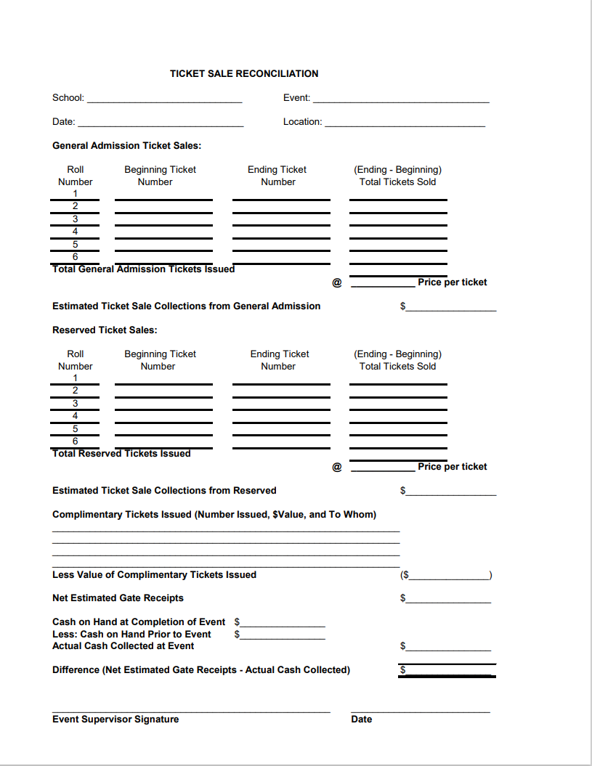
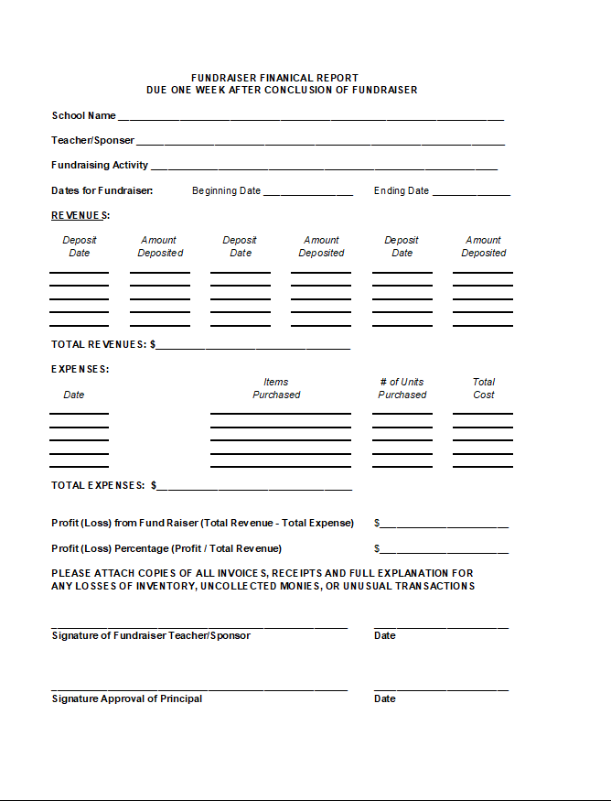
Fundraising/Ticket Reconciliation

Slide 11
Misc. Information
Journal adjustments must not have a $0.00 amount. Call the School Accounts Department to delete the transaction.
Extended day is activity account 2000.
Check the accounts payable often and delete items as necessary.

Slide 12
SCHOOL ACCOUNTS STAFF
Rhondalyn Williams, Internal Auditor
  225-922-5601
  rwilliams36@ebrschools.org
Mirza Nunez, School Accounts Auditor
  225-922-5539
  mnunez2@ebrschools.org
Lenesius Kinnon, School Accounts Auditor
  225-922-5549
  lkinnon@ebrschools.org
  Emily Bognar, School Accounts Specialist
  225-922-5562
  earceneaux@ebrschools.org

