Slide 1
Parental Involvement Activities That Work
2015-2016
presented by
Marlon Cousin, Title I Coordinator

Slide 2
Make the First Point of Contact a Positive one…
Have you sent a “happy note” or “quick note” home today?
A parent helps the child with a spelling test and the child does better. Shoot an immediate note home to say, “It’s working!”
How about a positive introductory phone call?
“Good News Postcards”—allows for teachers to write a short positive note about a student and forward to home

Slide 3
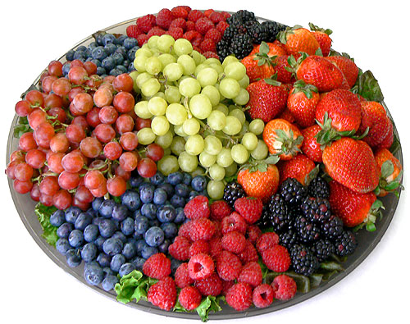
Remember the 3 “F”s for Success
Food
Families
Fun
Light refreshments

Slide 4
Muffins with Mom
Provides networking opportunities
Opportunities to convey information
Build relationships
Make it HIGH-IMPACT by modeling or demonstrating lessons/homework practices for parents

Slide 5
Donuts with Dad
Provides networking opportunities
Opportunities to convey information
Build relationships
Make it HIGH-IMPACT by modeling or demonstrating lessons/homework practices for parents

Slide 6
Breakfast Sessions
Coffee by Curbside
Coffee & Conversation
Great way to stress the importance of establishing study routines or to disseminate information about forthcoming high-stakes testing
Coffee and P.I.E. (Partners in Education)

Slide 7
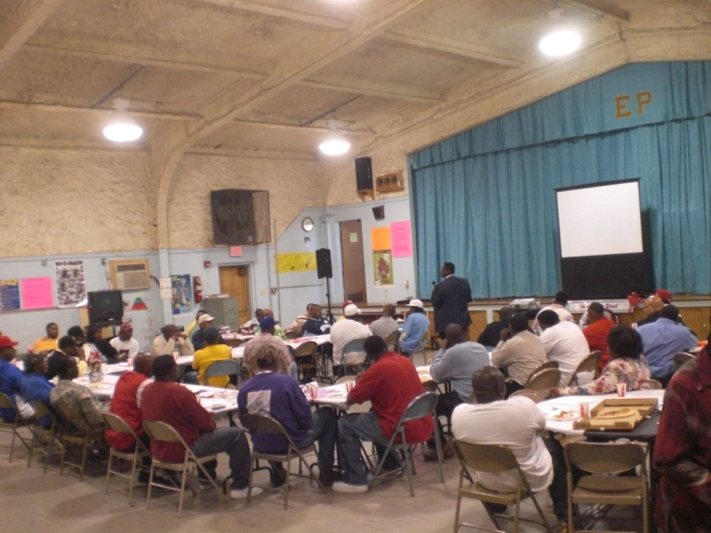
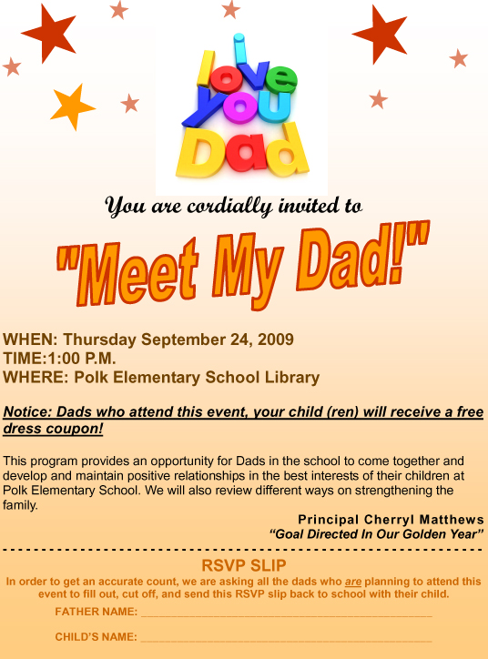
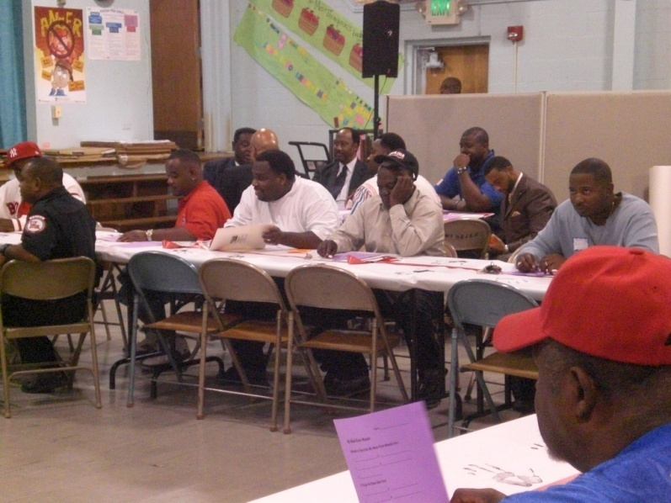
Meet My Dad!

Slide 8
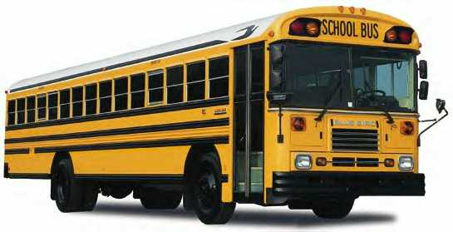
Send out the Welcome Wagon
Send a bus filled with staff around the school neighborhood to meet and welcome students and parents just before school starts.

Slide 9
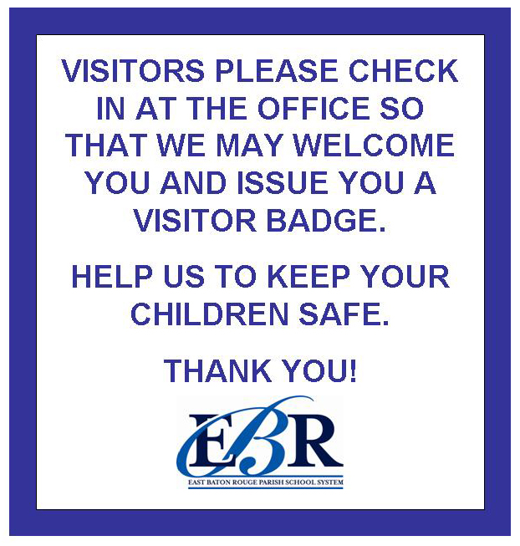
Family-Friendly Signage
Put up Family-Friendly signs at school directing parents to the office, cafeteria, gym, auditorium, etc.

Slide 10
Parent Lounge or Resource Center
Have some place in the building that parents can call their own.
Parents can obtain a wealth of information both school and non-school related

Slide 11
Display Student Work!
Have children’s work on display all over the school—every child’s work, not just the future commercial artists’ work.

Slide 12
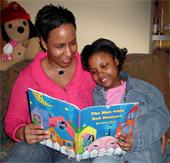
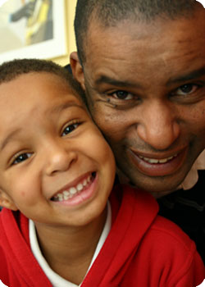
Take Parent’s Photos
Tell parents in advance that photos will be taken with their child, and prepare for a crowd.

Slide 13
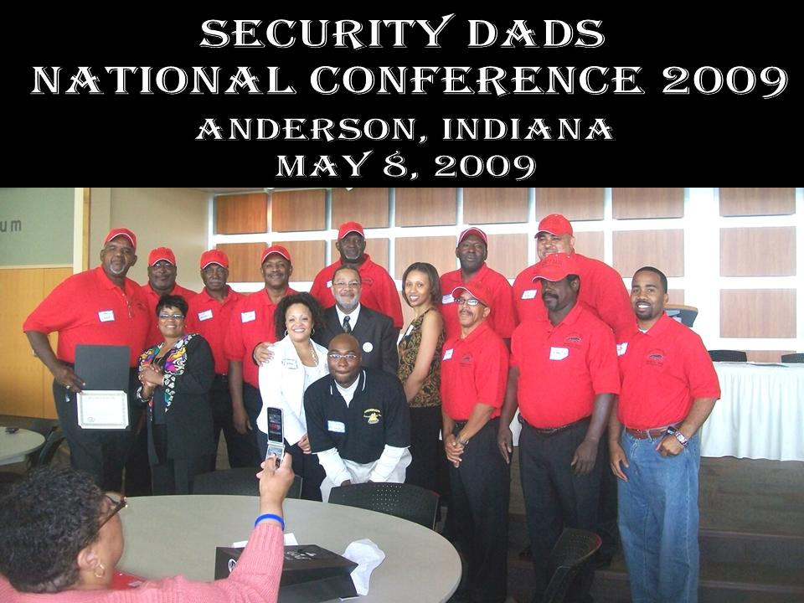
Create a Parent’s Hall of Fame
Everyone loves a “pat on the back” every now then.
This can be accomplished with a digital camera, color printer and Dollar Store frames.
Glen Oaks High School Security Dads

Slide 14
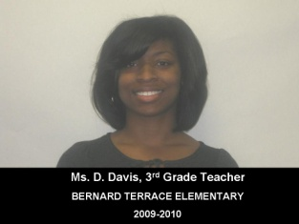
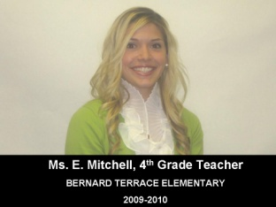
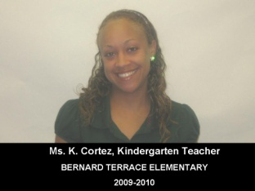
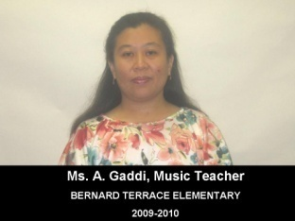
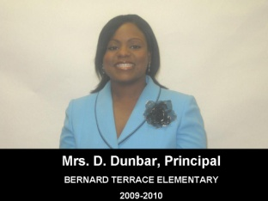
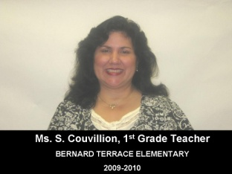
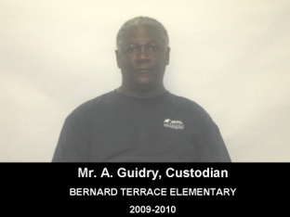
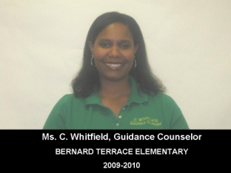
Showcase Your School’s Admin, Faculty & Staff
Notify Admin, Faculty & Staff in a timely manner for “Team Photo Day”
Photos can be taken with a digital camera
Create a “Team Showcase”
Print color photos
Identify “Team Members” accordingly
Frame with $1.00 photo frames from your friendly neighborhood Dollar Store®, Dollar General®, Dollar Tree®, or whatever is your flavor.

Slide 15
Take the Faculty/Staff Showcase as Step Further
Marlon Cousin, M.Ed.
Class of 2000
Personalize classroom door signs
Be Creative!
Room
213

Slide 16
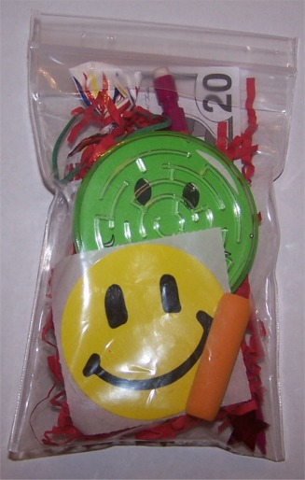
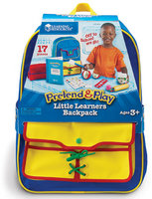
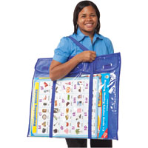
“Resource Bags”
Try sending home “Resource Bags” filled with games, videos, reading materials and instructions on specific activities parents can do with children at home.
You will find them to be very popular!

Slide 17
Family Movie Night
Utilize “Family Movie Night” as a behavior incentive in conjunction with PBIS
Show family appropriate movies in the school auditorium once a month
Once you get parents on campus—Seize the Moment!
Jackson Bayou Elementary
presents
“Family Movie Night”
Feature Movie of the Month
Cars 2

Slide 18
Topics Parents Want to Discuss and Gain Knowledge
“How to Talk So Kids Will Listen and Listen So Kids Will Talk”
“Dealing with Divorce”
“Mastering Math Facts”
“Talking with Kids About Sex”
“How to Handle Discipline”
“Proven Study Skills You Can Teach Your Child”
“Helping Your Child Survive First Grade (middle school, or whatever)”

Slide 19
Family Literacy Night
Promotes the involvement of parents and extended family members in the child’s educational programs and the development of literacy.
4 COMPONENTS OF FAMILY LITERACY:
Interactive literacy activities between parents and their children.
Training for parents on how to be a primary teacher for their children and full partners in the education of their children.
Parent Literacy training that leads to self-sufficiency.
An age appropriate education to prepare children for success in school and life experiences.

Slide 20
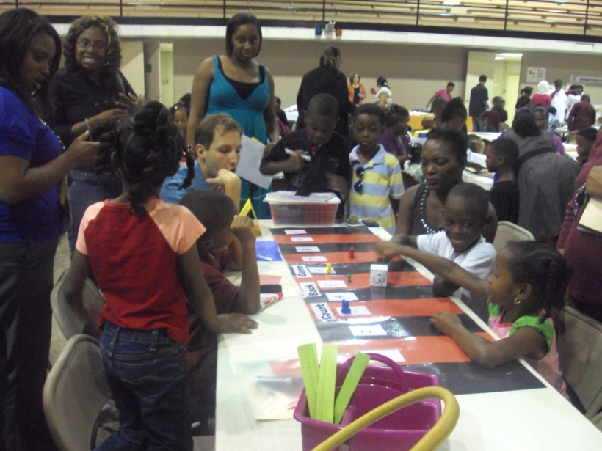
Family Math Night
Family Math Night is a fun event for kids in elementary school and their parents. It lets kids show off their math skills and introduces them to mathematical topics beyond their everyday schoolwork.
Parents get to see what their children are learning in math and maybe learn something new about mathematics themselves.

Slide 21
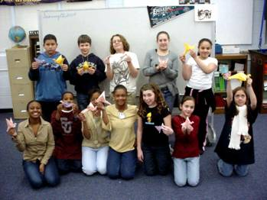
Student Demonstrations
Include student demonstrations at school meetings-not everything has to be a student “performance”.
Parents love to see their children in the spotlight!
How to Make Origamis

Slide 22
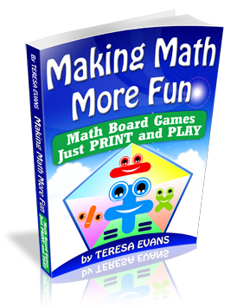
Set Up a Lending Library
Set up a lending library of at-home learning activities.
Title I Parental Involvement Funds can be utilized to purchase items for lending library

Slide 23
Phone Etiquette
Example of an appropriate greeting:
Good Morning!
It’s a great day at Mid-City Middle School, how may I assist you today?
Be very careful to monitor how your school’s telephone is answered.
Phone impressions are lasting ones!
Create a school greeting reflective of your school’s culture

Slide 24
Create a Brief Newsletter
A one-pager works best
Remember the “30-3-30” rule in writing school newsletters. Eighty percent of people will spend just 30 seconds reading it. Nineteen percent will spend three minutes. One percent will spend 30 minutes (your mother).

Slide 25
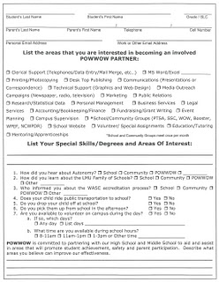
Surveys
Collaborate with colleagues to develop a survey to determine the type of topics and information that your target audience (parents) are interested in.

Slide 26
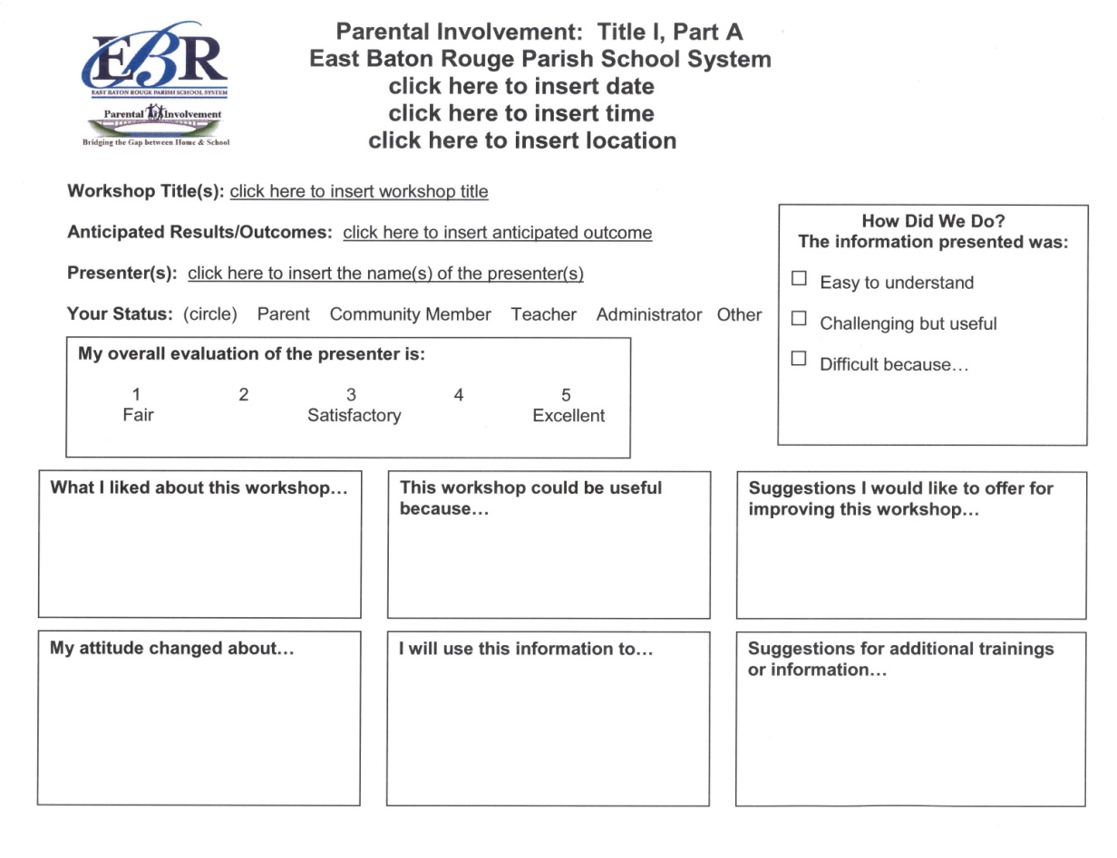
Evaluations
Use simple evaluation forms to get parent feedback on every meeting or event.

Slide 27
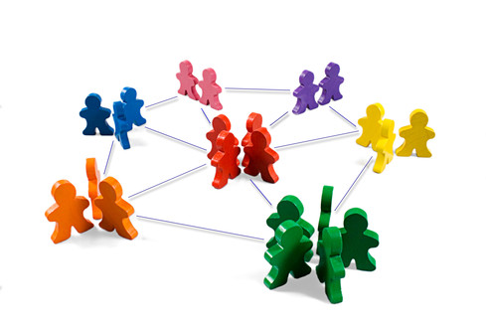
Work for Links With Other Social Service Agencies That Can Help Parents

Slide 28
Final Thought:
Parents will change as the children grow and progress from one classroom or site to another, yet the principles and steps in planning for effective parental engagement remain the same.
The program belongs to EVERYONE involved.
Each person—parent, child, teacher– has a vested interest and personal benefits to reap.

Slide 29
Q&A

Slide 30
Contact Information
Marlon K. Cousin, Coordinator of Title I
(225)922.5593
mcousin@ebrschools.org

