Slide 1
Effective Strategies for Parental Involvement
2015-2016
presented by
Marlon Cousin, Title I Coordinator

Slide 2
Objectives / Focus Areas:
Understand the necessary steps in systematically planning for varied parent involvement in your school
Recognize the reasons to involve parents and importance of setting goals
Identify general and specific ways to involve Male Parents
Provide an overview of a variety of parental resources
Create an action plan for increased parental involvement

Slide 3
What are your expectations for today’s session?
Do you have questions that you would like answered concerning parental involvement?

Slide 4
THAT’S ME
I have a good idea of the academic progress of my child
I can contact my child’s teachers and get my questions answered
I know who to talk to if I feel I am not able to communicate my child’s needs with the teacher
I feel my child’s school welcomes and encourages parent involvement
10. I hope my child goes to college
I have a child in elementary school
I have a child in middle school
I have a child in high school
I feel like I understand what my child is being taught
I regularly attend meetings at my child’s school

Slide 5
One Size Does Not Fit All
“We need to work to develop parent involvement that fits the needs of the specific people in our community”.
Scheurich, James Joseph. Leadership in Excellence and Equity

Slide 6
Differentiated Outreach Plan
Create a culture of comfort for families
Change mindset of HOW we meet parents
Think about THEIR needs
Go into the community and build relationships
Increase Communication
Consider “Off Campus” activities

Slide 7
FOCUS QUESTIONS:
What is your philosophy of parental engagement?
How do you currently involve male parents in your program?
What barriers prevent you from reaching all parents?
On a scale of 1-10, how would you rate parent involvement in your program?

Slide 8
What We Know:
Parent Involvement is a crucial component of an effective educational program.
When families are involved in their children’s education, student achievement increases.
Parents are the child’s first and continuing teachers. Children’s growth and development are more readily assured when the home and school work together.

Slide 9
Things We Know About Parental Involvement
Schools typically place parental involvement low on the list of things to improve schools.
If a school is good at engaging parents, student achievement will go up.
Schools struggling to improve student achievement must make better efforts to get parents involved
Children from minority and low income families benefit the most from parental involvement

Slide 10
3 Main Reasons to Involve Parents
Parental participation helps the children; especially the Male influence
It benefits the educational program.
It is rewarding to the parents themselves.

Slide 11
Strategies to Foster Relationships Between Home and School
TEAM
APPROACH

Slide 12
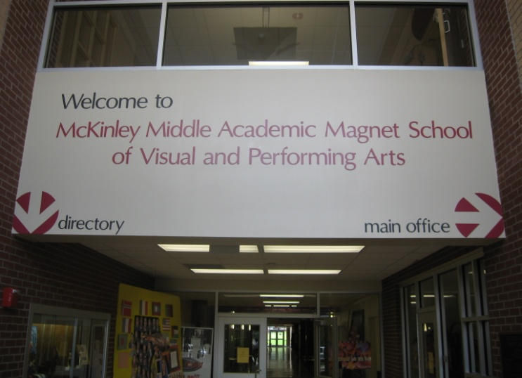
Friendly Environment
Create a welcoming climate in your school
Start with the Leadership of the school and Office Staff
Set the tone for treating Parents with dignity and respect
Build relationships with trust and consistency

Slide 13
Action Steps for Effective Parental Involvement
Establish a philosophy or rationale
Develop goals
Assess needs and resources
Design objectives
Identify necessary resources
Evaluate what was accomplished
By following the steps, you can assure that you achieve your goals for home / school / community partnerships.

Slide 14
Where Do You Begin?
Before beginning any parent involvement program, think about your philosophy.
Do you view parent involvement from the perspective of the program or the perspective of the parent?

Slide 15
Establishing Goals / Priorities
Go beyond just “informing” parents about the educational program and the child’s progress.
Develop more ambitious and comprehensive goals.
Develop a One-Year Action Plan
*as per the National Network of Partnership Schools (Johns Hopkins University)

Slide 16
EXAMPLES:
Include parents in planning, implementing, and evaluating the educational program
Provide situations where parents can meet and share ideas, concerns, and activities with parents of other children
Help parents learn about resources available to them as needed
Encourage parents to reinforce and enrich children’s learning through suitable parent-child activities at home

Slide 17
Assessing Needs / Interests
Assessing concerns and needs are necessary to ensure that planned activities are relevant to parents’ lives.
Developing a parent program without consulting the parents can result in low interest and participation.

Slide 18
Assessing Needs / Interests (continued)
Needs Assessment Examples:
Ideas for parent group discussions, conferences, newsletters, parent projects, articles for parents, educational resources, etc.
Understand parents’ interests / skills and ideas for participating in the program
Community agencies and professional groups can provide suggestions for activities and topics

Slide 19
How do you conduct a Needs Assessment?
Telephone or face to face interviews
Suggestion box
Written questionnaire or “interest finder”
Application or registration information
Evaluation of previous activities
Discussion groups
Observations of parent-child-teacher relationships
Inventory available resources

Slide 20
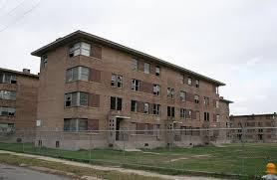
What Factors Should be Considered?
Circumstances in which the children and families live
Ethnic characteristics
Family Structure
Occupations / educational backgrounds of parents

Slide 21
Defining Objectives
Your goals and needs assessment will guide the development of ways in which parents will be involved.
This will help you to establish objectives for parental involvement in your program.
Share objectives through newsletters, website, bulletin boards, memos, etc…

Slide 22
Specific Ways to Involve Parents
The diversity among parents and the variety of their needs and interests require variety in activities.

Slide 23
Understanding the Five Critical Roles
Of Parents in Your Program

Slide 24
1. Parents are Learners
Parents are involved in providing the child the kind of home environment which can assure school success.
The parent can be helped to develop a better self-concept, a better attitude towards school, and an understanding of the child’s capabilities, ways in which learning is enhanced, the effect of the home on the child’s learning, and the importance of good nutrition.

Slide 25
2. Parents are Resources
Reading Friends
Tutoring
The individual talents, skills and insights of parents can be used to enrich class activities and to strengthen two-way communication between home and school.
Diversity of age and ethnicity can enrich the experiences for all persons involved.
Campus Beautification
Projects
Foster Grandparents
PARENT PATROL
Publish Parent
Newsletter

Slide 26
COMMUNITY RESOURCES
Brainstorm a list of Community Resources that could be brought into your school for an opportunity for Families to learn about available services.
COMMUNITY RESOURCE FAIR?

Slide 27
3. Parents are Decision-Makers
Parents can participate in decisions about program planning for their children since they are the “experts” regarding their own children.
They can also be involved in the needs assessment and evaluation for the class or program by providing their statements of needs and their perceptions about the effectiveness of the program.
NCLB requires that parents are included and are active members of each school’s School Improvement Team or Parent Advisory Council.

Slide 28
4. Parents are Advocates
Parents may assume advocacy roles to help outside agencies and community leaders respond to children’s needs and to the home-school relationship.
Parents can take a pro-active stance in regard to the welfare of all young children and appropriate programs to enhance their growth and development.

Slide 29
5. Parents are Teachers
Learning-training activities for parents and child occur in the classroom, center, and home. The parent is the child’s most significant teacher.
Provide opportunities for parents to improve their understanding of how children learn so they can help with homework.

Slide 30
Identify Resources for Parents
Scholarships or loans for families in need
Family / Parent Resource Center
Include sporting activities to involve “fathers”
Refreshments for parent activities
Materials for parent workshops
Resources for learning activities in the home for parents
Consider offering GED classes

Slide 31
High-Impact Activities
Parents need specific information and modeled demonstrations on how they can help and what they can do.
FOR EXAMPLE:
Teacher modeling reading comprehension strategies for parents

Slide 32
Creating Family Engagement Teams
Here in the EBPPSS we are in the process of establishing Action Teams for Partnerships (ATPs), as prescribed by the National Network of Partnership Schools (NNPS).

Slide 33
What is an Action Team for Partnerships?
The Action Team for Partnerships (ATP) is an action arm—a committee or work group—of a School Council or School Improvement Team.
If a school has no council or improvement team, the ATP is a special committee for planning and conducting partnerships, working with and advising the principal on this component of school improvement.

Slide 34
What is an Action Team for Partnerships? (continued)
The ATP writes and implements plans for family and community involvement that will help produce desired results for students, families, and the school as a whole.
The ATP includes teachers, administrators, parents, and students at the high school level, and it may include family members or business and community partners.
Members of the ATP work together to review school goals, select, design, implement, and evaluate partnership activities; and improve practices of family and community involvement.

Slide 35
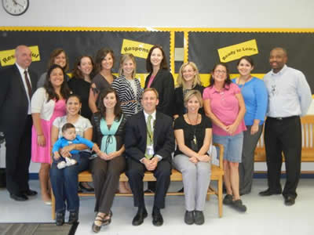
Who are the Members of the ATP?
A well functioning ATP has 6 to 12 members.
Members include at least two teachers, at least two parents, an administrator, and others who have important connections with families and students (e.g., counselor, school nurse, social worker, Title I Parent Liaison, PTO Officer or representative, etc.)
ATP can also include representatives from the community (e.g., business partners, interfaith leaders, etc.)

Slide 36
What Does an ATP Do?
The ATP writes a plan, implements, delegates, and coordinates activities, monitors progress, solves problems, publicizes activities, and reports on the school’s program of partnerships to the School Council or similar body and to other appropriate groups.
Members of the ATP do not work alone.
They recruit other teachers, students, admin, parents, and community members, etc.
The ATP also recognizes the family and community involvement activities conducted by individual teachers and other groups such as PTO.

Slide 37
How Should an ATP Organize Its Work?
An ATP may organize its work by focusing on specific school improvement goals or on the six types of involvement.
This choice determines the structure of the ATP’s committees, how One-Year Action Plans for Partnerships are written, and how the program is evaluated.
Organize ATP committees to help reach school improvement goals.
“Goals Approach”
The ATP creates committees with chairs and co-chairs and members who become the school’s experts on how family and community involvement can help students reach selected academic and non-academic goals such as improving reading, math or science skills; improving attendance and behavior; or other goals for creating a welcoming school environment for all families and students.

Slide 38
How Should an ATP Organize Its Work? (continued)
Field tests indicate that ATPs can effectively address four school improvement goals each year—two academic goals, one behavioral goal, and one goal to conduct activities that create a welcoming school climate and sense of community.
Another way to organize ATP committees, plans , and evaluations is to focus on the six types of involvement:
Parenting
Communicating
Volunteering
Learning at Home
Decision Making
Collaborating with the Community
In this, the “Types Approach,” the ATP creates six committees, each with a chair or co-chairs and members who become the school’s experts on each type of involvement.

Slide 39
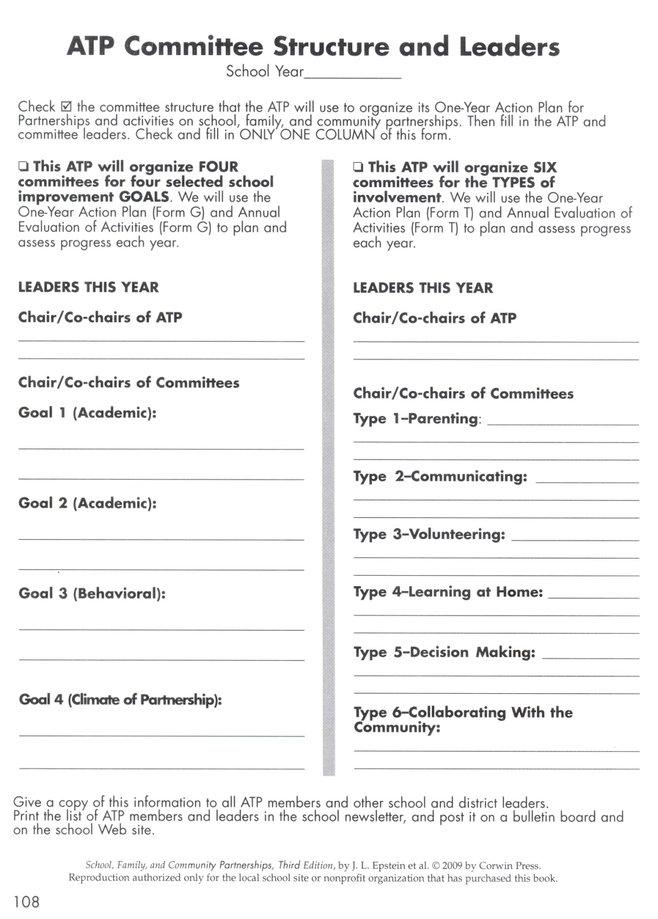

Slide 40
How Do Members of the ATP Share Leadership?
All members of the team (ATP) contribute ideas to the One-Year Action Plan for Partnerships; lead, co-lead, or assist on committees; delegate leadership and mobilize support for the activities; and evaluate the results of their efforts (Epstein, 2001).
Each ATP has a chairperson, or optimally, co-chairs. Co-chairs should be educators and parents who are recognized and accepted as leaders by all team members.
ATP committees also have a chair or co-chairs. The co-chair structure gives greater stability to the ATP and its committees in case some members leave the school.
Action Team
for Partnerships (ATP)
Principals
Families
Students
(High School
Only)
Other
School
Personnel
Community
Partners
Teachers

Slide 41
How Do Members Become an Effective Team?
*Only a well functioning team, however, will produce the desired results.
Teachers, administrators, parents, community partners, and others on ATP must learn to function well as a team.
They meet each other, learn each other’s strengths and talents, set ground rules for communicating, plan and implement activities, produce results, evaluate activities, share successes, solve problems, replace members who leave, and improve plans and processes over time to sustain their work as a team.
The team, itself, is a message that educators, parents, and community partners will work together to help more students succeed in school.

Slide 42
How Often Should an ATP Meet?
Whole Team Meetings
The full ATP should meet at least monthly for one or two hours.
Each meeting should have a well-planned agenda that reinforces teamwork and that keeps the activities in the One-Year Action Plan for Partnerships moving forward.
Committee Meetings
ATP committees are subgroups of the full team who take charge of planning, conducting or delegating, and evaluating the involvement activities for different sections of the One-Year Action Plan for Partnerships.

Slide 43
PARENTAL INVOLVEMENT ACTIVITIES THAT WORK…

Slide 44
Make the First Point of Contact a Positive one…
Have you sent a “happy note” or “quick note” home today?
A parent helps the child with a spelling test and the child does better. Shoot an immediate note home to say, “It’s working!”
How about a positive introductory phone call?
“Good News Postcards”—allows for teachers to write a short positive note about a student and forward to home

Slide 45
Remember the 3 “F”s for Success
Food
Families
Fun
Light refreshments

Slide 46
Muffins with Mom
Provides networking opportunities
Opportunities to convey information
Build relationships
Make it HIGH-IMPACT by modeling or demonstrating lessons/homework practices for parents

Slide 47
Donuts with Dad
Provides networking opportunities
Opportunities to convey information
Build relationships
Make it HIGH-IMPACT by modeling or demonstrating lessons/homework practices for parents

Slide 48
Breakfast Sessions
Coffee by Curbside
Coffee & Conversation
Great way to stress the importance of establishing study routines or to disseminate information about forthcoming high-stakes testing
Coffee and P.I.E. (Partners in Education)

Slide 49
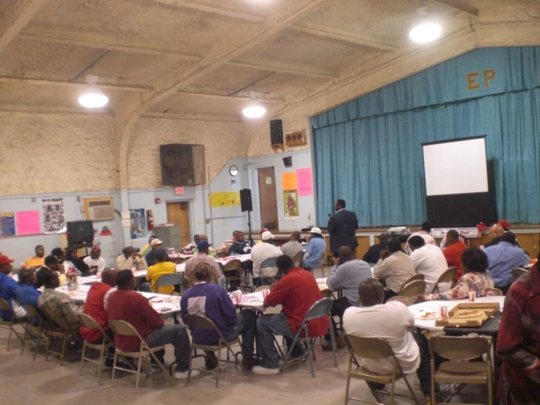
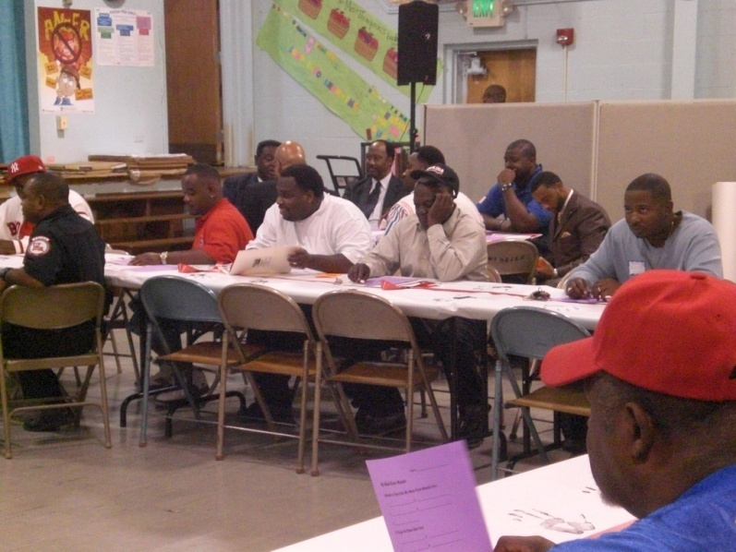
Meet My Dad!

Slide 50
Send out the Welcome Wagon
Send a bus filled with staff around the school neighborhood to meet and welcome students and parents just before school starts.

Slide 51
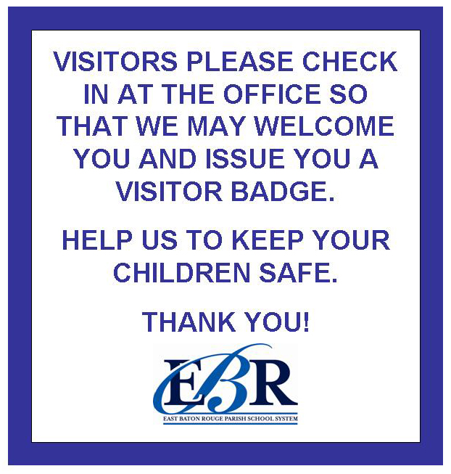
Family-Friendly Signage
Put up Family-Friendly signs at school directing parents to the office, cafeteria, gym, auditorium, etc.

Slide 52
Parent Lounge or Resource Center
Have some place in the building that parents can call their own.
Parents can obtain a wealth of information both school and non-school related

Slide 53
Display Student Work!
Have children’s work on display all over the school—every child’s work, not just the future commercial artists’ work.

Slide 54
Take Parent’s Photos
Tell parents in advance that photos will be taken with their child, and prepare for a crowd.

Slide 55
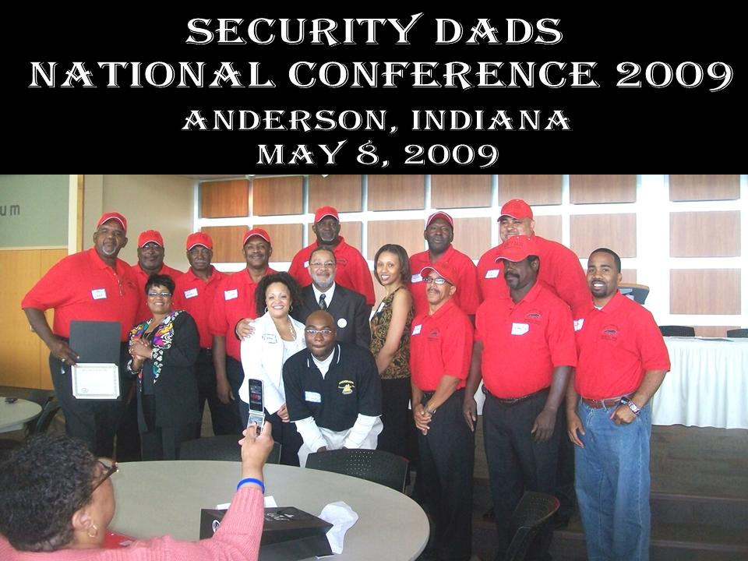
Create a Parent’s Hall of Fame
Everyone loves a “pat on the back” every now then.
This can be accomplished with a digital camera, color printer and Dollar Store frames.
Glen Oaks High School Security Dads

Slide 56
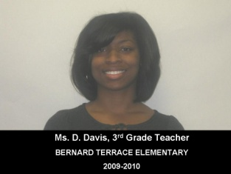
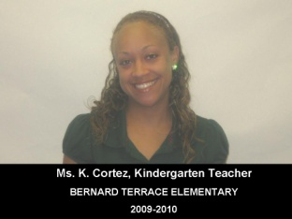
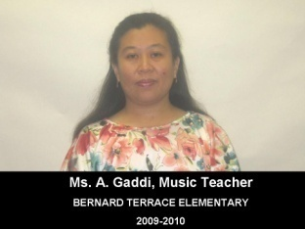
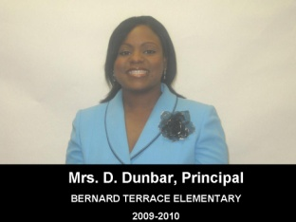
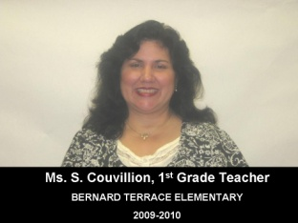
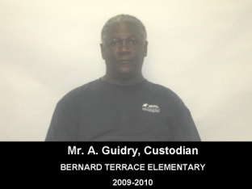
Showcase Your School’s Admin, Faculty & Staff
Notify Admin, Faculty & Staff in a timely manner for “Team Photo Day”
Photos can be taken with a digital camera
Create a “Team Showcase”
Print color photos
Identify “Team Members” accordingly
Frame with $1.00 photo frames from your friendly neighborhood Dollar Store®, Dollar General®, Dollar Tree®, or whatever is your flavor.

Slide 57
Take the Faculty/Staff Showcase as Step Further
Marlon Cousin, M.Ed.
Class of 2000
Personalize classroom door signs
Be Creative!
Room
213

Slide 58
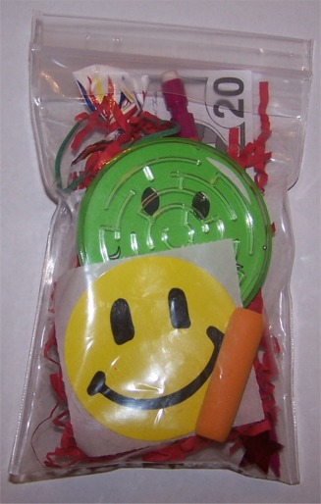
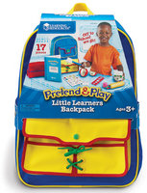
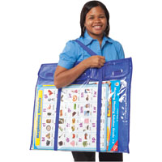
“Resource Bags”
Try sending home “Resource Bags” filled with games, videos, reading materials and instructions on specific activities parents can do with children at home.
You will find them to be very popular!

Slide 59
Family Movie Night
Utilize “Family Movie Night” as a behavior incentive in conjunction with PBIS
Show family appropriate movies in the school auditorium once a month
Once you get parents on campus—Seize the Moment!
Jackson Bayou Elementary
presents
“Family Movie Night”
Feature Movie of the Month
Cars 2

Slide 60
Topics Parents Want to Discuss and Gain Knowledge
“How to Talk So Kids Will Listen and Listen So Kids Will Talk”
“Dealing with Divorce”
“Mastering Math Facts”
“Talking with Kids About Sex”
“How to Handle Discipline”
“Proven Study Skills You Can Teach Your Child”
“Helping Your Child Survive First Grade (middle school, or whatever)”

Slide 61
Family Literacy Night
Promotes the involvement of parents and extended family members in the child’s educational programs and the development of literacy.
4 COMPONENTS OF FAMILY LITERACY:
Interactive literacy activities between parents and their children.
Training for parents on how to be a primary teacher for their children and full partners in the education of their children.
Parent Literacy training that leads to self-sufficiency.
An age appropriate education to prepare children for success in school and life experiences.

Slide 62
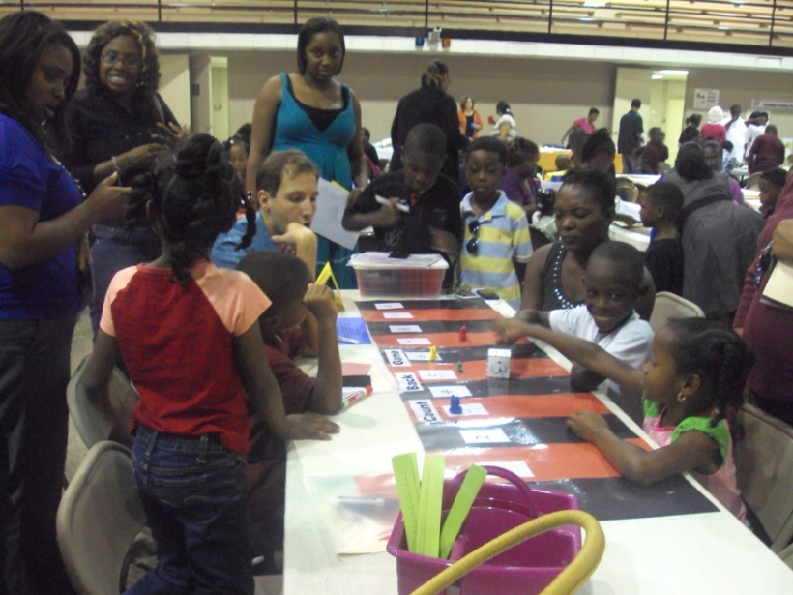
Family Math Night
Family Math Night is a fun event for kids in elementary school and their parents. It lets kids show off their math skills and introduces them to mathematical topics beyond their everyday schoolwork.
Parents get to see what their children are learning in math and maybe learn something new about mathematics themselves.

Slide 63
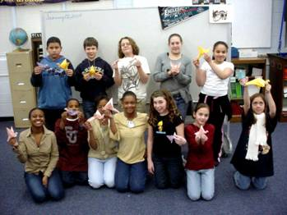
Student Demonstrations
Include student demonstrations at school meetings-not everything has to be a student “performance”.
Parents love to see their children in the spotlight!
How to Make Origamis

Slide 64
Set Up a Lending Library
Set up a lending library of at-home learning activities.
Title I Parental Involvement Funds can be utilized to purchase items for lending library

Slide 65
Phone Etiquette
Example of an appropriate greeting:
Good Morning!
It’s a great day at Mid-City Middle School, how may I assist you today?
Be very careful to monitor how your school’s telephone is answered.
Phone impressions are lasting ones!
Create a school greeting reflective of your school’s culture

Slide 66
Create a Brief Newsletter
A one-pager works best
Remember the “30-3-30” rule in writing school newsletters. Eighty percent of people will spend just 30 seconds reading it. Nineteen percent will spend three minutes. One percent will spend 30 minutes (your mother).

Slide 67
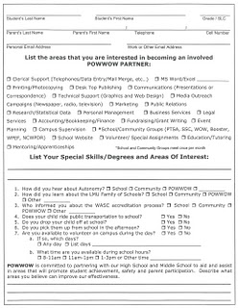
Surveys
Collaborate with colleagues to develop a survey to determine the type of topics and information that your target audience (parents) are interested in.

Slide 68
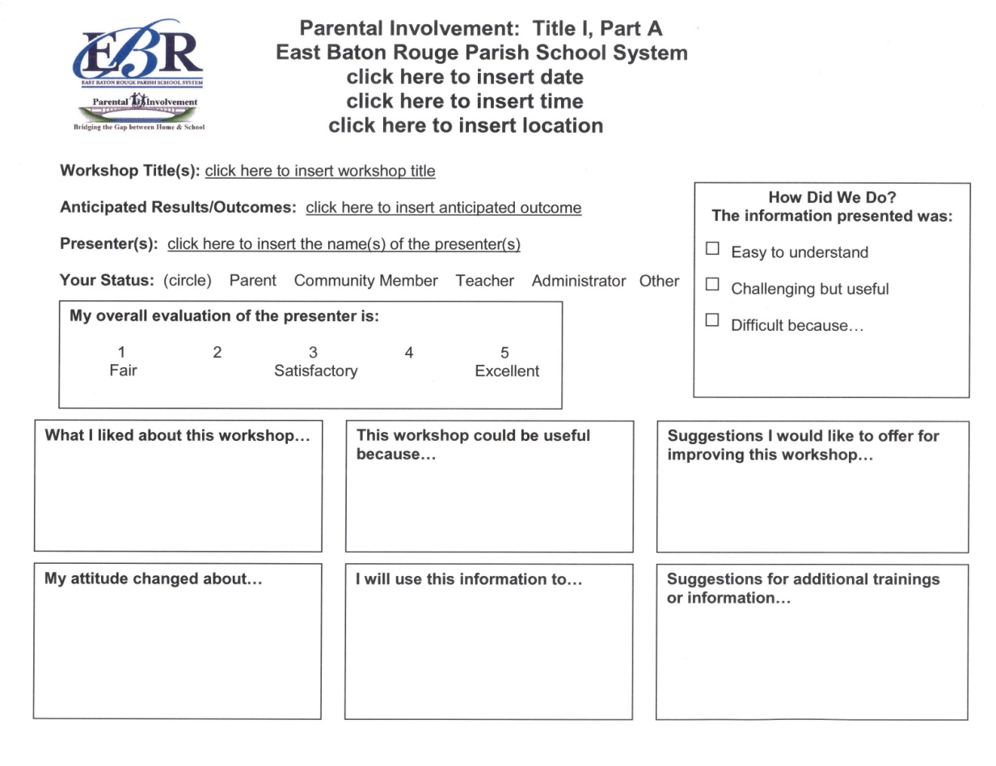
Evaluations
Use simple evaluation forms to get parent feedback on every meeting or event.

Slide 69
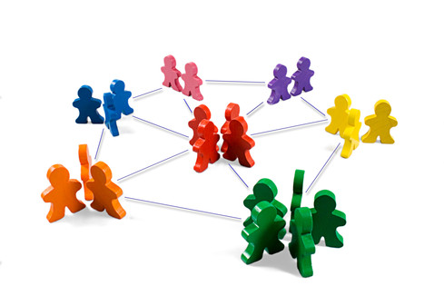
Work for Links With Other Social Service Agencies That Can Help Parents

Slide 70
Final Thought:
Parents will change as the children grow and progress from one classroom or site to another, yet the principles and steps in planning for effective parental engagement remain the same.
The program belongs to EVERYONE involved.
Each person—parent, child, teacher– has a vested interest and personal benefits to reap.

Slide 71
Q&A

Slide 72
Contact Information
Marlon K. Cousin, Coordinator of Title I
(225)922.5593
mcousin@ebrschools.org

